Slide 1


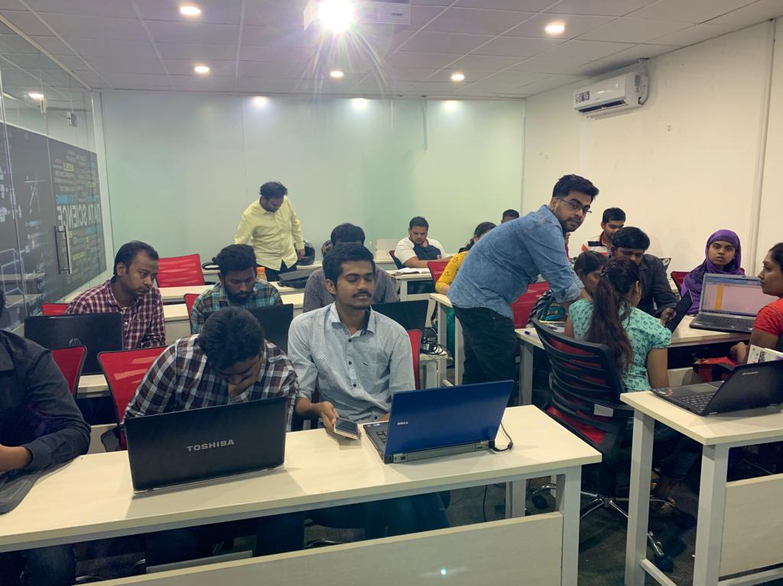





Slide 2
Internship project title: MOVIES RECOMMENDER SYSTEM
Team 13
ERRAM PRITHVI RAJ
AAKASH KOVAI
KASUKURTI SHIVA KUMAR
DHREETI KESHARWANI
DHRUV DIXIT

Slide 3
Contents
Introduction
Preliminary tasks
Popularity based Recommendation System
Content based Recommendation System
Collaborative filtering based Recommendation System
Deployment
Challenges faced
Future scope

Slide 4
Movie RECOMMENDATION SYSTEMS
A movie recommendation system, or a movie recommender system, is an ML-based approach to filtering or predicting the users' film preferences based on their past choices and behavior.
Movie recommender system is just another application of Recommender systems which are primarily used in commercial applications such as Amazon, Netflix, Spotify, YouTube, etc.
Types of recommender systems: Non-personalized: Popularity based: Trending Personalized: Content-based filtering: Item data focused
Collaborative filtering: User data focused
Why do we need Movie recommender systems:
Organization’s perspective: Customer retention Increased revenue generation
User perspective: Fulfilling their needs in a shorter time period To overcome decision-fatigue

Slide 5
Problem statement and plan of action
Decision-making in modern era is one of the most time consuming problems one faces. The logical and scientific reasons behind this are many, but this can comprehended in simple terms as "A lot of choices means no choice at all" ,i.e., when provided with lots of choices, the user is confused to such an extent to make decisions that s/he is not able to pick even one. Ex: Even high-end coffee shops and restaurants uses the concept of providing the day-wise best on the menu. This way the customer happily decides the meal in earliest of time.
Same is the case with many digital domains. One of which is Movies in the head domain of Entertainment. So, here is what we are making "Movie Recommender system" that helps the individuals to reduce their decision fatigue by recommending them the movies based on top charts, popularity, genre, cast, director, previous watched movie features etc.

Slide 6
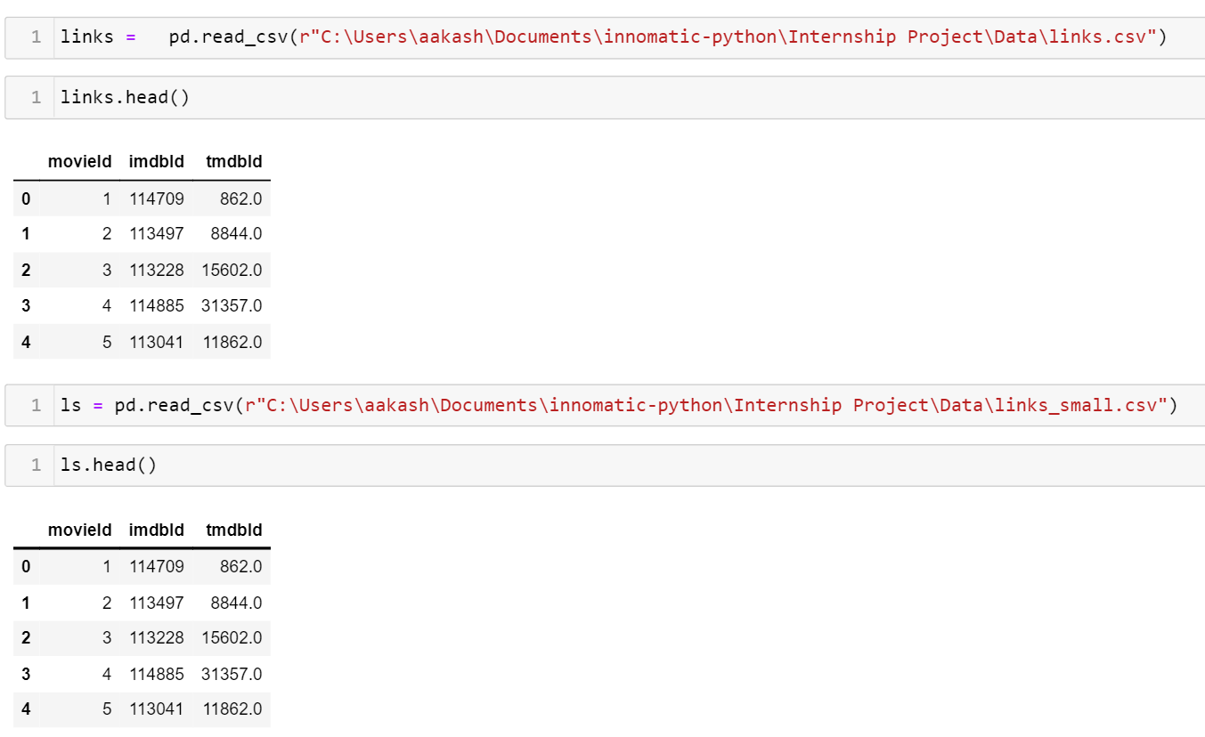
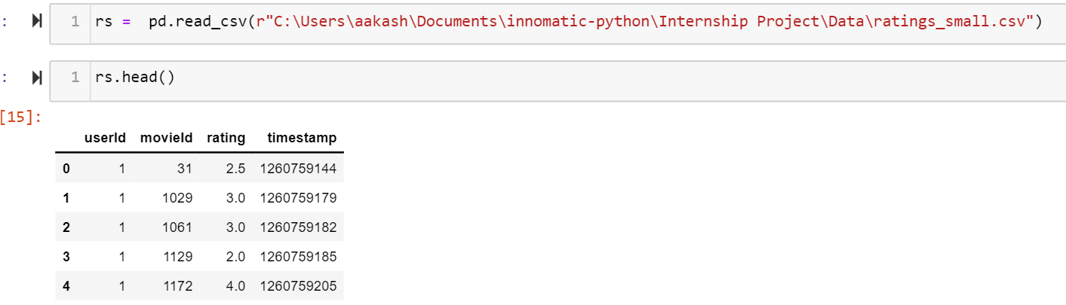
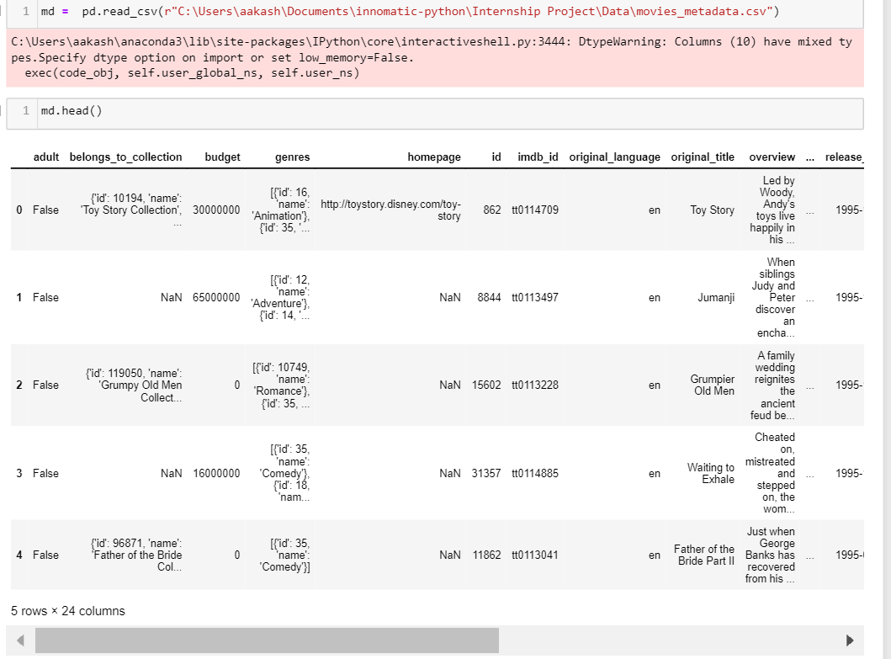
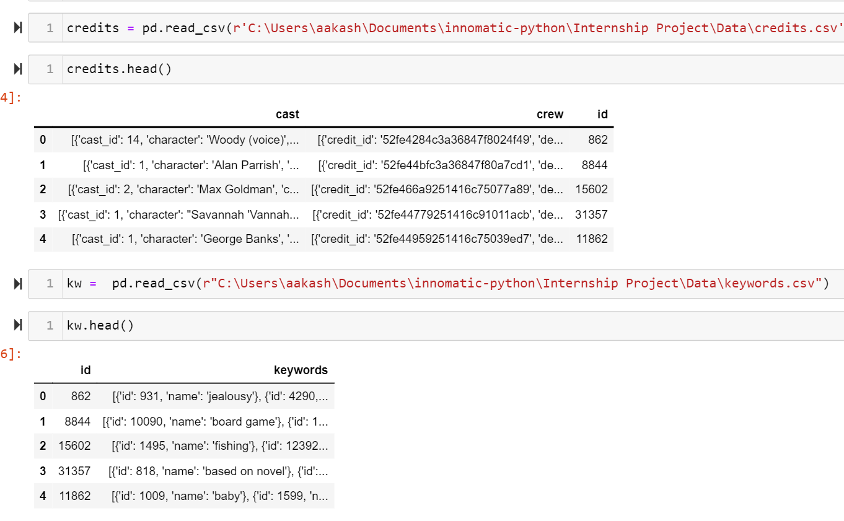
Datasets :

Slide 7
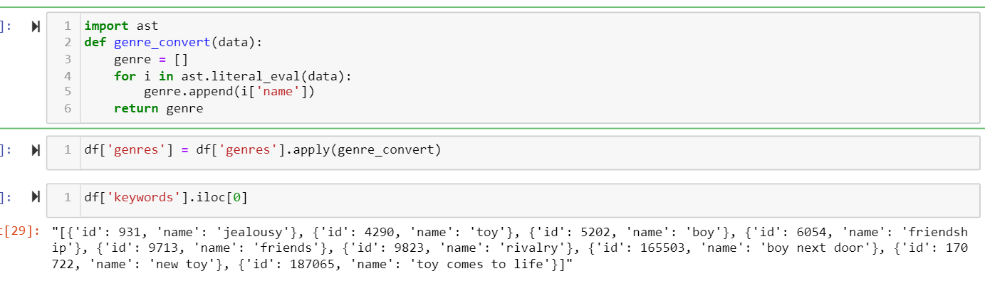
Text Pre-Processing :

Slide 8
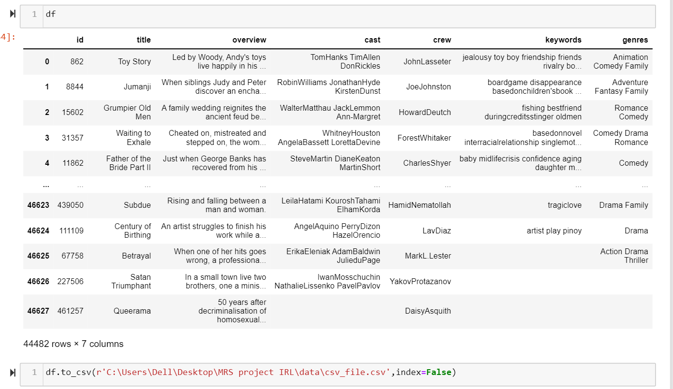

Slide 9
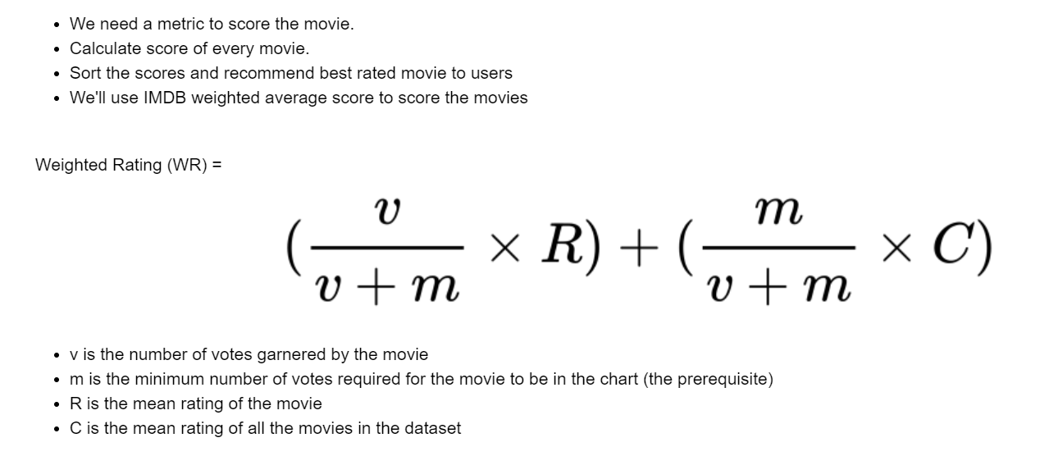
Popularity Recommendation system
Method – Weighted Rating

Slide 10
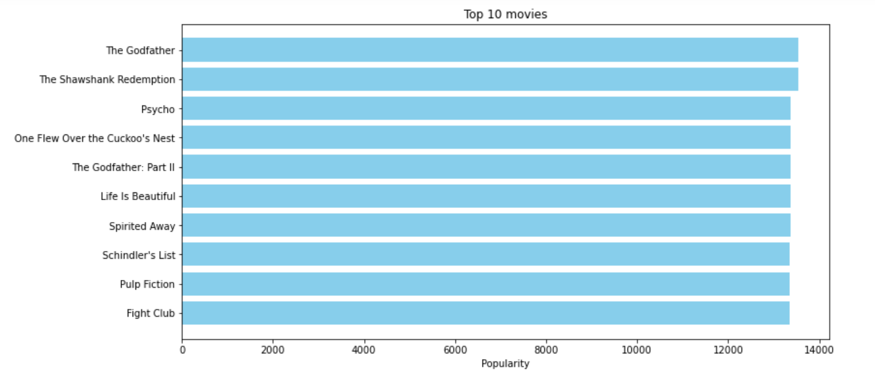
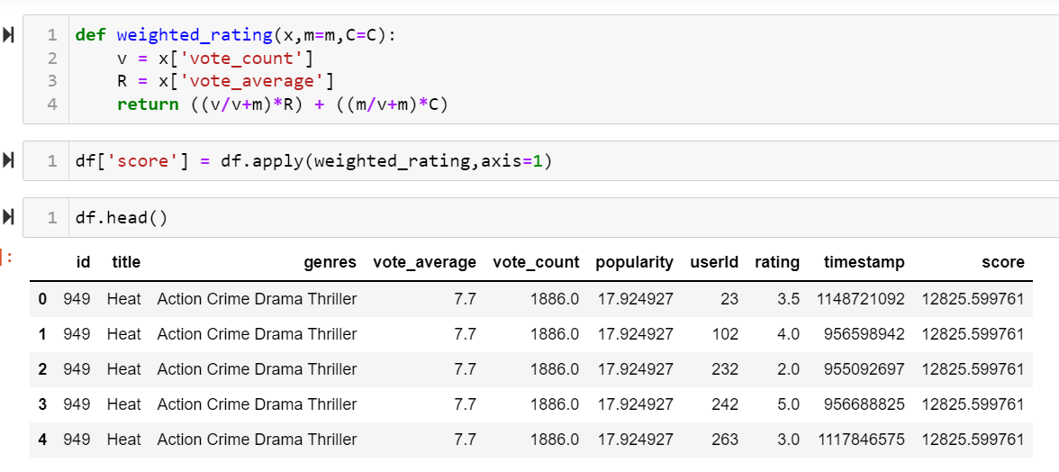
Implementation and Visualization :

Slide 11
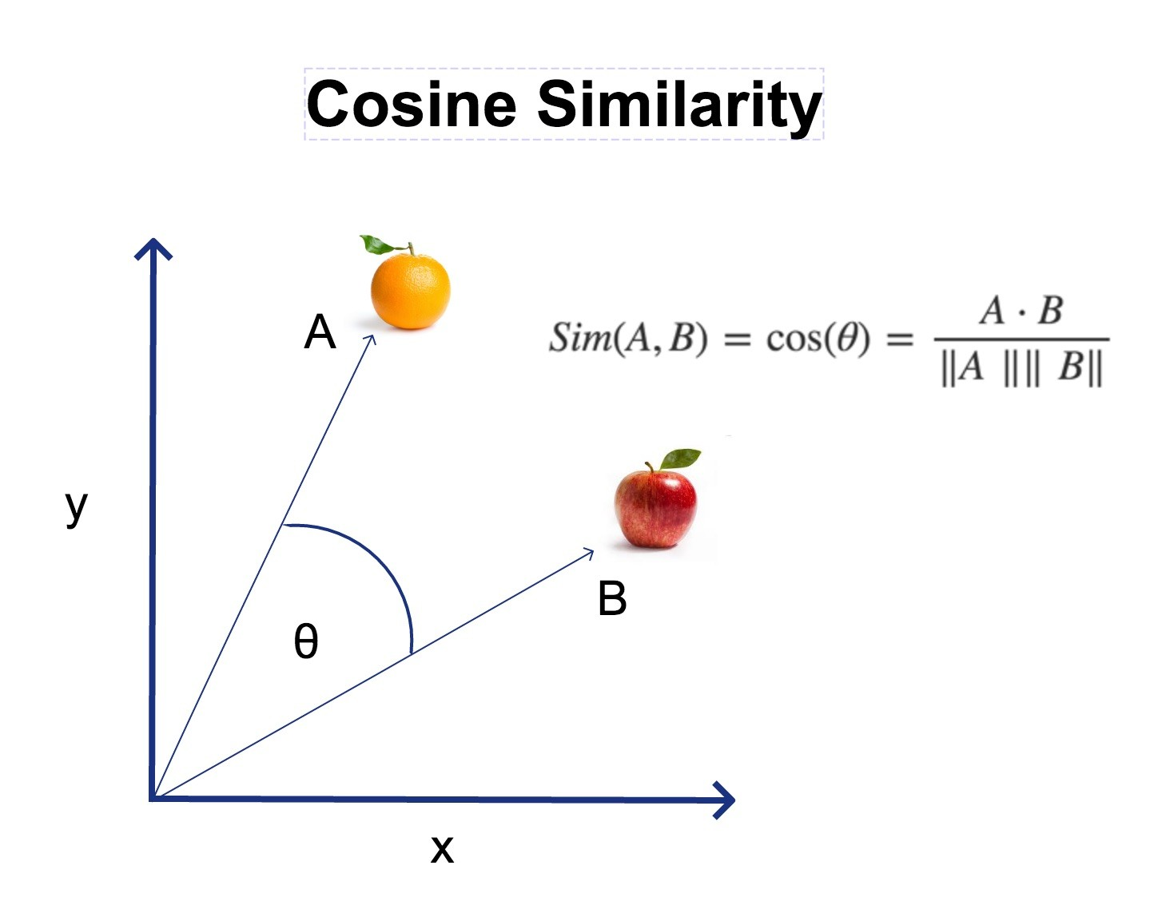
Content Based Recommendation System

Slide 12
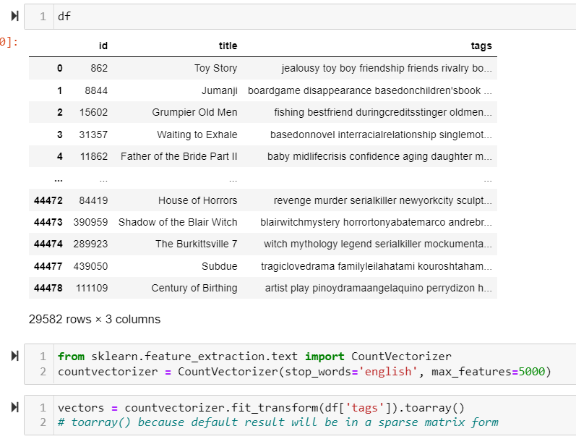
Dataset for Content Based Recommendation System

Slide 13
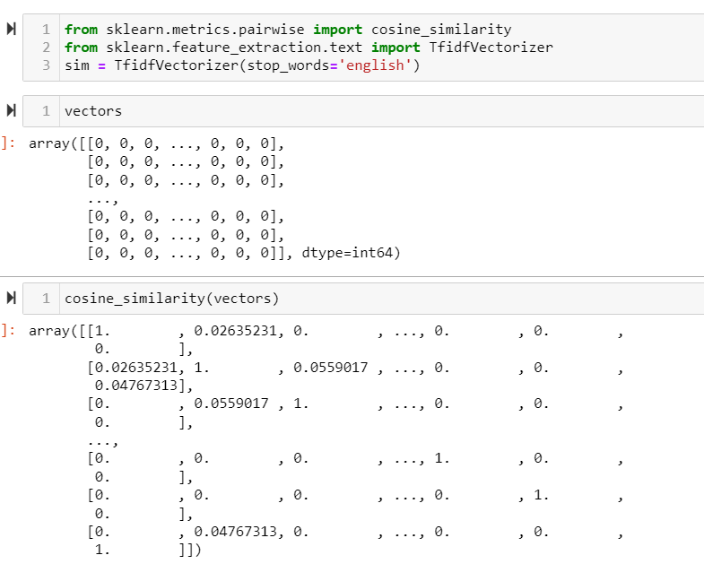

Slide 14
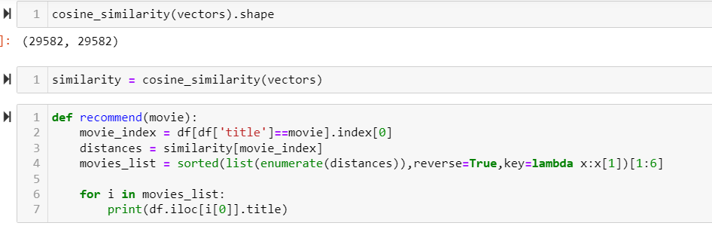

Slide 15
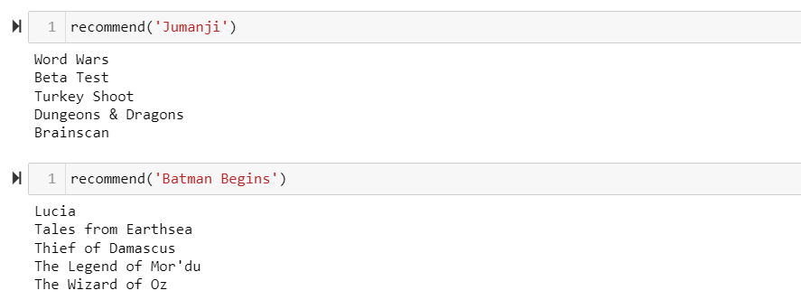

Slide 16
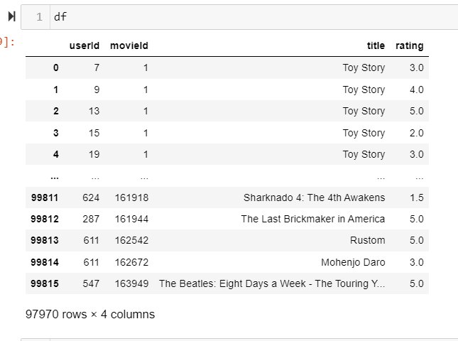
Collaborative Filtering Based Recommendation System

Slide 17
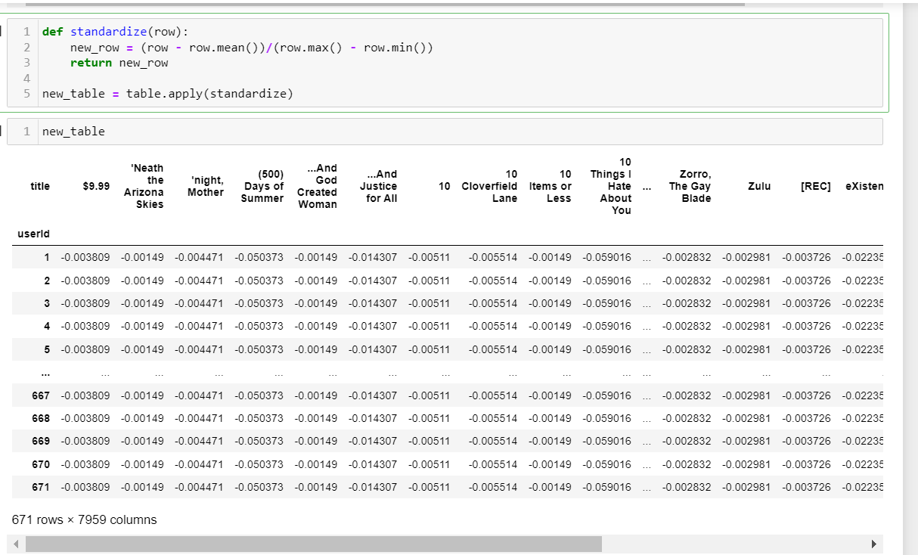
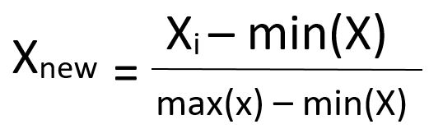

Slide 18
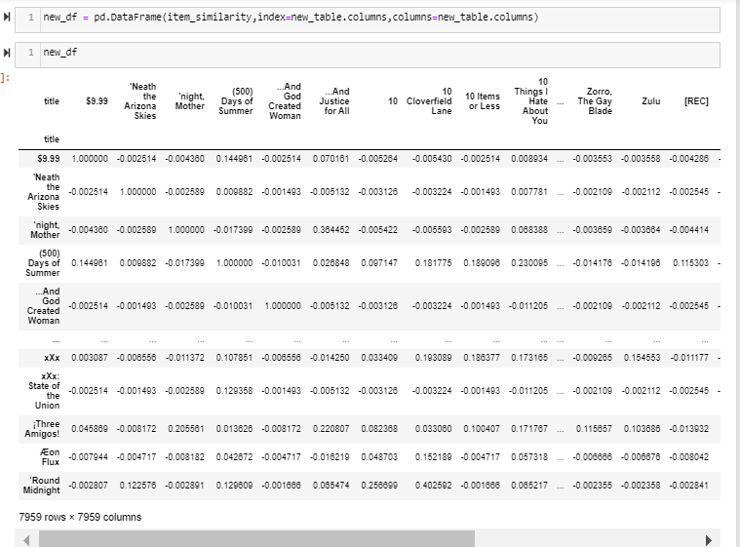
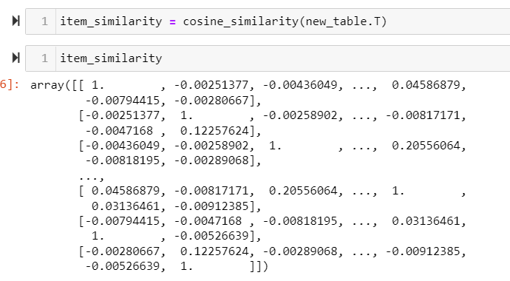

Slide 19
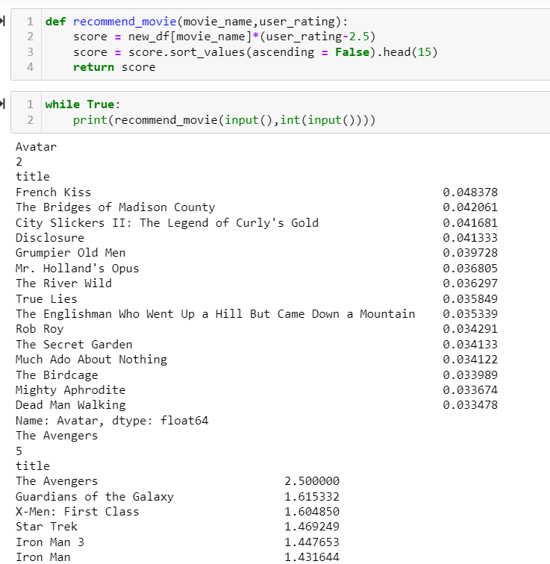

Slide 20
FRONT END OF DEPLOYMENT
The front-end consists of 4 web pages:
About Page - The first page which is displayed to the user is about page where user finds out a paragraph related to the movie recommendation system.
Content Based Recommendation System Page - On this page, the user give some input by selecting a movie from the drop-down menu and click on the show recommendation button then a list of recommended movie based on content filtering technique is displayed.
Collaborative Based Recommendation System Page - On this page, the user give input by selecting a movie and a rating on it then a list of recommended movies displayed to the user based on the collaborative filtering technique.
Popularity Based Recommendation System Page - On this page, the user finds the movies which are popular at that time according to the user id.

Slide 21
DEPLOYMENT WORKFLOW
This project is basically an implementation of Movie Recommender System using different filtering techniques used in machine learning.
Different pages in the app are using different filtering techniques based on which user get the resultant movie recommendations.
User can get a list of movies as an output when go on popularity based recommender system page where movies displayed according to user id.
User can get movie recommendations based on content based filtering technique by providing a movie as input or selecting it from the drop-down menu.
User can get movie recommendations based on collaborative based filtering technique by providing a movie as input or selecting it from the drop-down menu and set the rating using range parameter.

Slide 22
MODULES USED IN DEPLOYMENT
During the development of the project following modules were imported-
os
streamlit
pickle, load
pandas
numpy
scipy, sparse
sklearn.metrics.pairwise, cosine_similarity

Slide 23
LINKS FOR DEPLOYMENTS
https://movies--recommend--system.herokuapp.com/
https://dhruvdixit06-movierecommendationsystem-about-1bhjal.streamlitapp.com/

Slide 24
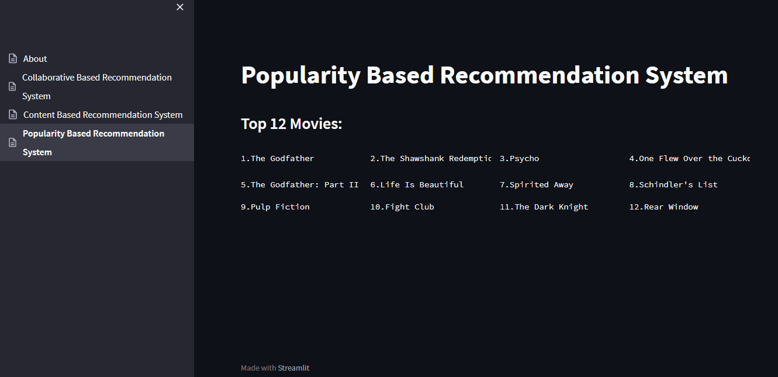
SCREENSHOTS OF RECOMMENDATIONS

Slide 25
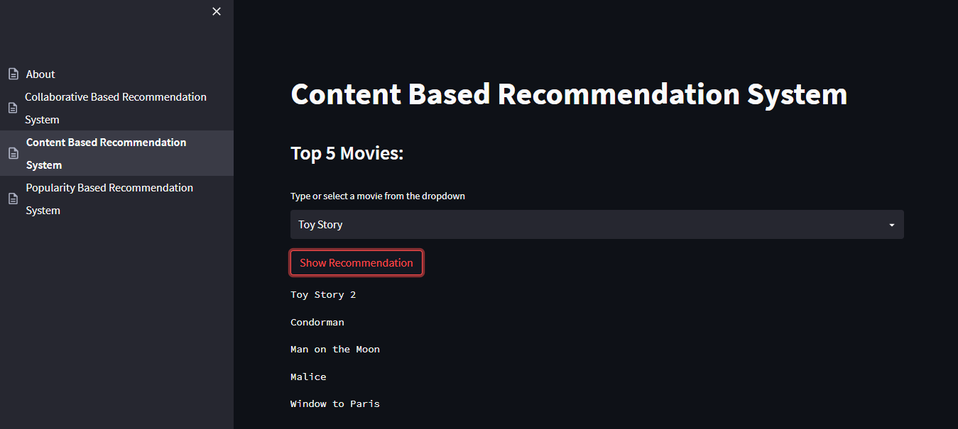

Slide 26
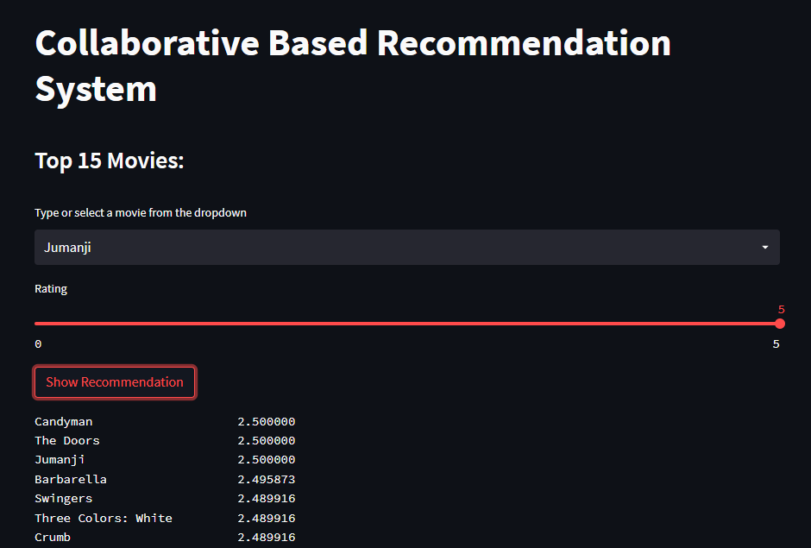
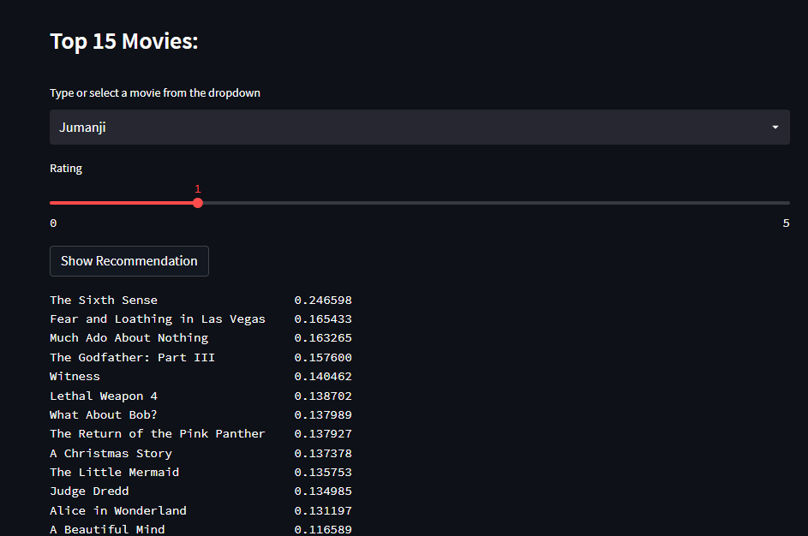

Slide 27
CHALLENGES FACED
In pre-processing stage: Wrong type of “id” data Merging columns after .csv conversion
Lemmatizing required data in Content based RecSys
SVD
Faulty recommendations in Collaborative filtering RecSys for low rated movies
Deployment challenges: 1. Static deployments which showed same results even on changing data Solution: Made the code dynamic with reference of help from various github projects 2. Uploading large model files which were greater than 6gb as github didn’t support upload sizes greater than 25mb via browser and 100mb via CLI Solution: Used GIT LFS using CLI 3. Large model files(.pkl) which were of greater than 6gb were generated which slowed down the prediction process Solution: Compressed model files of large size using bz2file compression(.pbz2)

Slide 28
FUTURE SCOPE
Better recommendations in terms of changes in user’s interests
More focus on item-based rather than user-based
Not to recommend movies already watched by the user
Improvements in search results
To find a way to reduce faulty recommendations in an account which is used by multiple users

Slide 29
THANK YOU

